Slide 1
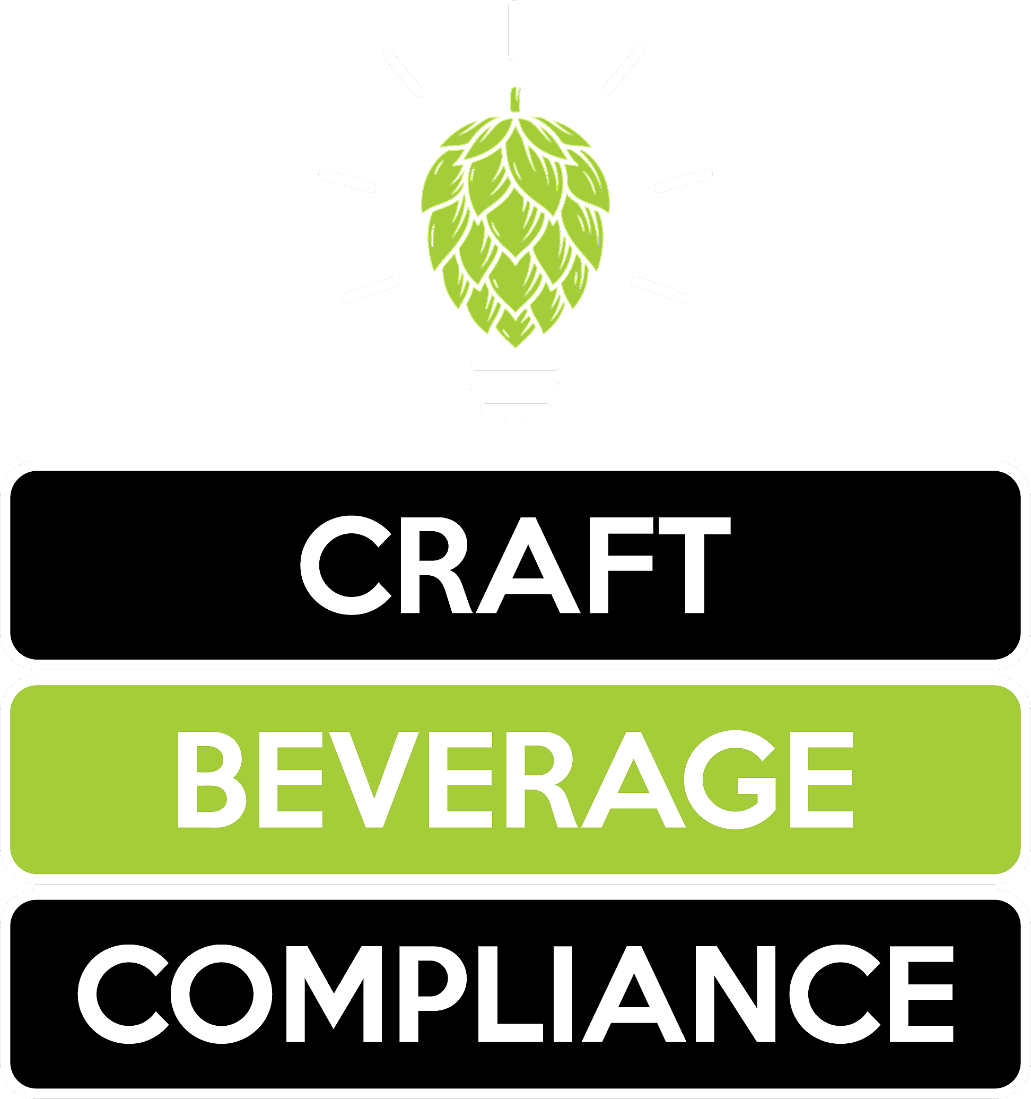
An Overview of Reporting Requirements

Slide 2
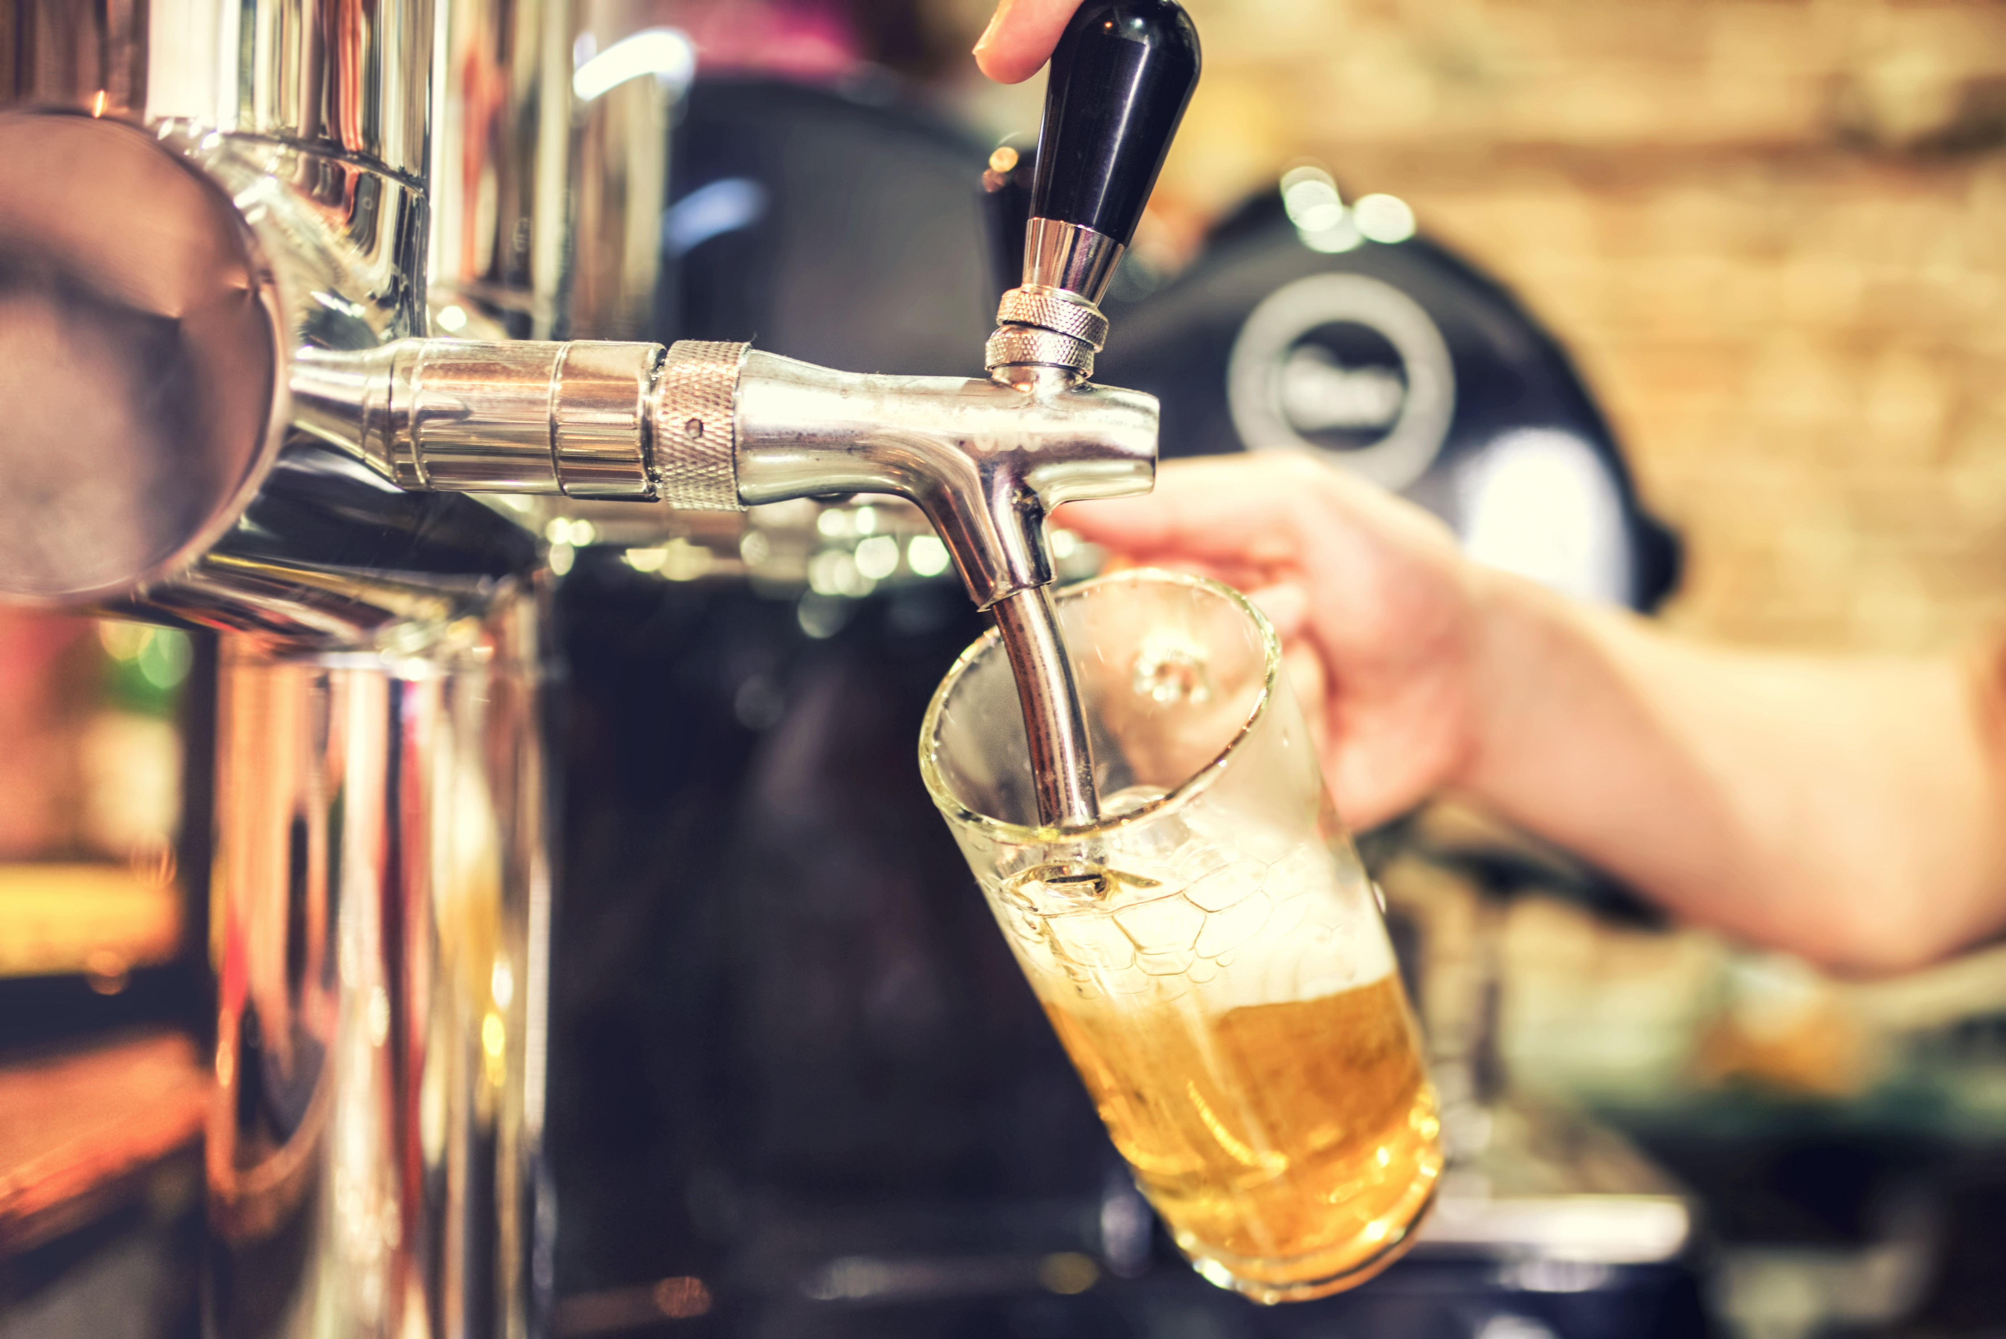
YouR HAPPY PLACE

Slide 4
STATE
COUNTY&
CITY
FEDERAL

Slide 5
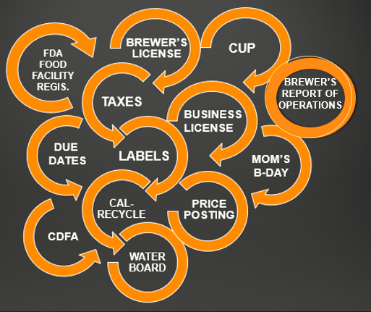

Slide 7
DON’t F*#K UP

Slide 8
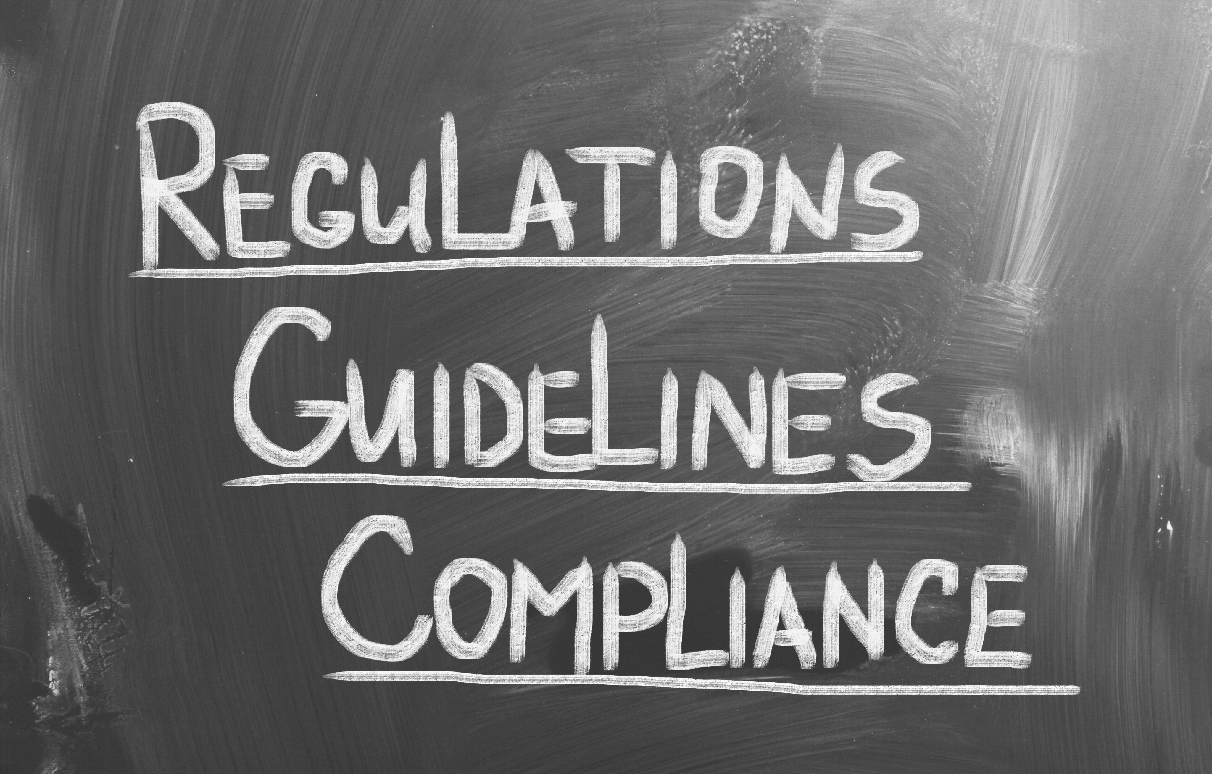

Slide 9
Common Filings/Reporting

Slide 10
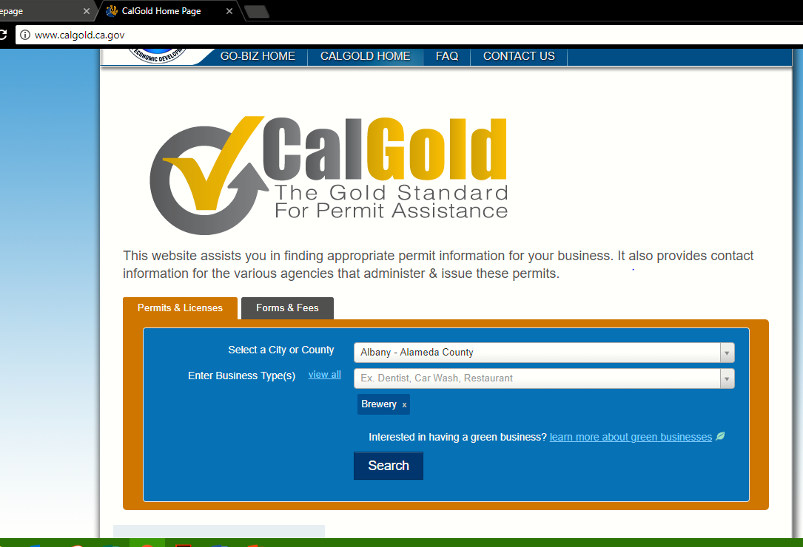
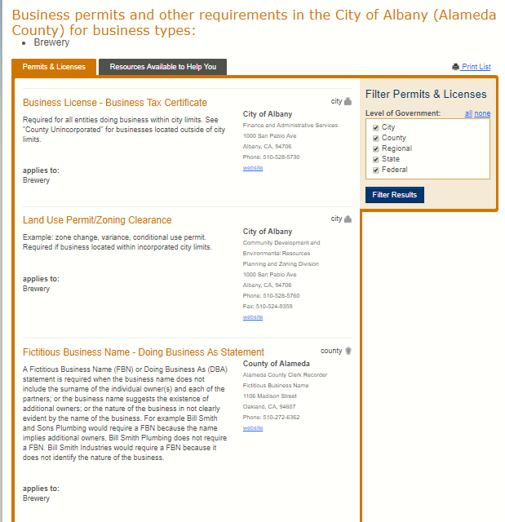
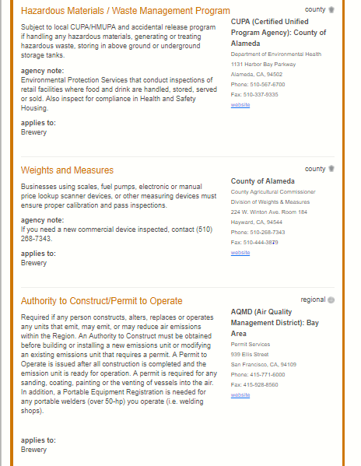
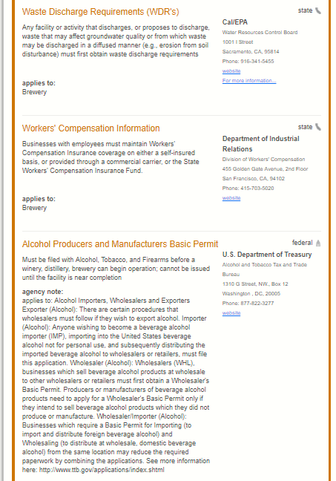
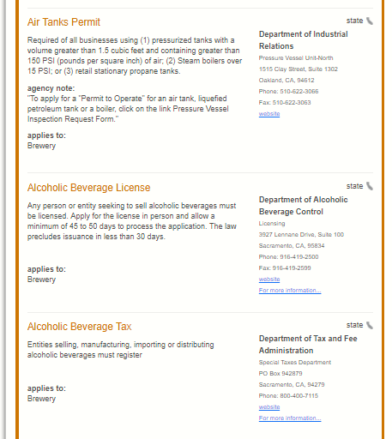
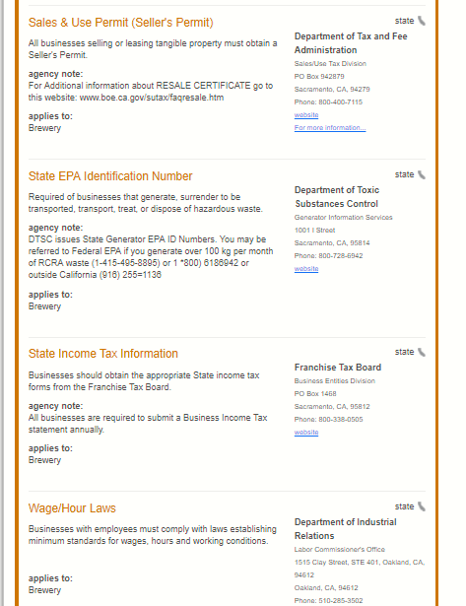
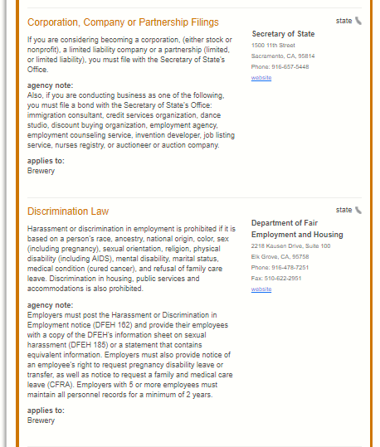
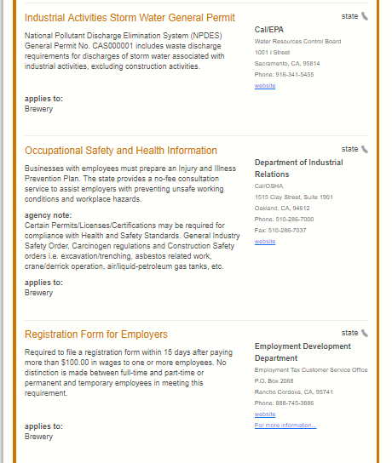
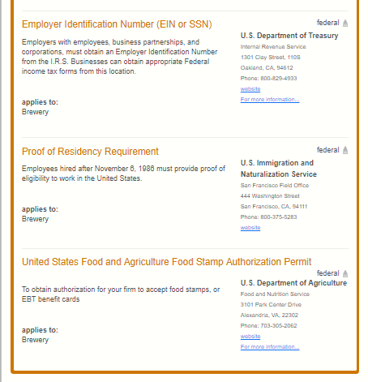
http://www.calgold.ca.gov/
Your County
BR

Slide 12
Break it down.

Slide 13
Common Filings/Reporting
CALIFORNIA

Slide 14
ABC
Brand Registration
Price Posting
Premises updates
When?
As needed.

Slide 15
ABC - Brand Registration
Labels

Slide 16
ABC - Brand Registration
Alcohol Content
>5.7%
“CONTAINS ALCOHOL”

Slide 17
ABC - Brand Registration
CALIFORNIA-SPECIFIC REQUIREMENTS
Mandatory Information | Placement | font size | Legibility | Add'l notes
CA - alcohol content statement | front, back or side | compliant with TTB minimum font requirements | if alcohol content is greater than 5.7% by volume, the ABV must be stated on the label in a format compliant with TTB requirements
CA - "CONTAINS ALCOHOL" statement | front (may be horizontal or vertical) | minimum 3mm in height | must be distinguishable from the background & conspicuous | a malt beverage that derives 0.5% or more of its alcoholic content by volume from flavors or other ingredients containing distilled alcohol shall bear a distinctive, conspicuous & prominently displayed label containing the phrase "CONTAINS ALCOHOL" (statement included in the brand's primary front label is acceptable)

Slide 18
ABC - Brand Registration
6 MANDATORY statements:
Alcohol Content
Brand Name
Class Type Designation
Name & Address
Net Contents
Health Warning Statement
Font Size Placement Legibility

Slide 19
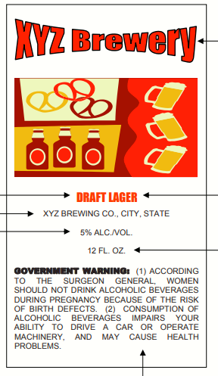
ABC - Brand Registration
DON’T DO:
“ABV”
“IPA”
“16 OZ”

Slide 20
ABC - Brand Registration
ALCOHOL CONTENT STATEMENT:
Only when alcohol content is required by state law (optional for TTB), then it must be shown only as one of the following 4 ways: 1. "ALC. XX% BY VOL." (or spelled out) 2. "ALC. BY VOL. XX%" (or spelled out) 3. "XX% ALC. BY VOL." (or spelled out) 4. "XX% ALC./VOL." (or spelled out) Must be expressed to the nearest 0.1%
DON’T DO:
“ABV”
“IPA”
“16 OZ”
CLASS/TYPE DESIGNATION:
Must be stated as an acceptable class and/or type designation as established by the TTB under Chapter 4 of the BAM, or as otherwise accepted by the TTB from time to time.
NET CONTENTS:
Containers <1 pint must be shown in fluid ounces or fractions of a pint Containers = 1 pint (16oz) must be stated as “1 PINT” (or “PT”)
Containers >1 pint but < 1 quart, must be shown in pints and fluid ounces or fractions of a quart
Containers = 1 Quart (32 ounces) must be stated as "1 QUART" (or "QT") Containers > 1 quart but < 1 gallon must be stated in quarts, pints and fluid ounces or fractions of a gallon
Containers = 1 gallon must be stated as “1 GALLON” (or “GAL”)
Containers > 1 gallon must be stated in gallons and fractions of gallons

Slide 21
TTB - Formulas
27 CFR Part 25 (Formulas)
27 CFR 25.55 – 25.58
TTB Ruling 2015-1 – list of exempt ingredients/processes
See also
https://ttb.gov/beer/labeling.shtml
for link to the Code of Federal Regulations

Slide 22
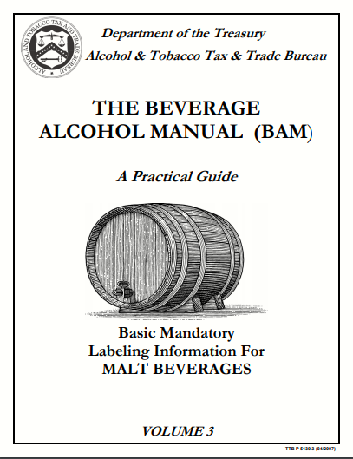
ABC - Brand Registration
TTB BAM: https://www.ttb.gov/beer/bam.shtml

Slide 23
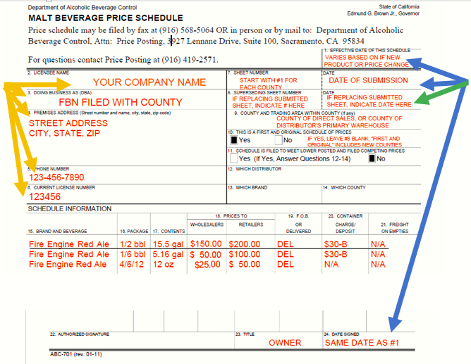
ABC – PRICE POSTING
Sign up to file online with FORM ABC-702
FORM ABC-701

Slide 24
ABC – PREMISES UPKEEP
Changes to your premises after qualification…
Did my changes impact my production output (tax liability)?

Slide 25
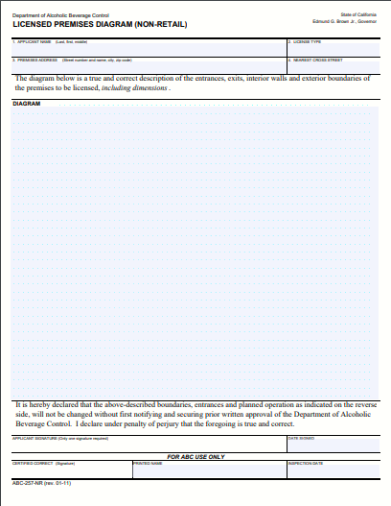
ABC
FORM ABC-257NR – Licensed Premises Diagram
FORM ABC-253 – Supplemental Diagram

Slide 26
CalReycle
Beverage Manufacturer (BM)
… who bottles, cans, or otherwise fills beverage containers, or imports filled beverage containers, for sale to distributors, dealers, or consumers.
Beverage Distributor (DS)
… who engages in the sale of beverages in beverage containers to a dealer in California, including any manufacturer who engages in these sales.
Division of Recycling Integrated Information System (DORIIS)
California Department of Resources Recycling and Recovery
http://www.calrecycle.ca.gov/Business/Regulated.htm

Slide 27
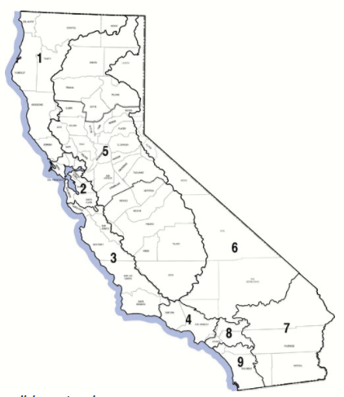
State Water Resources Control Board (SWRCB)
National Pollutant Discharge Elimination System (NPDES)
No Exposure Certification: https://www.waterboards.ca.gov/water_issues/programs/stormwater/docs/toolbox/nec_brochure.pdf

Slide 28
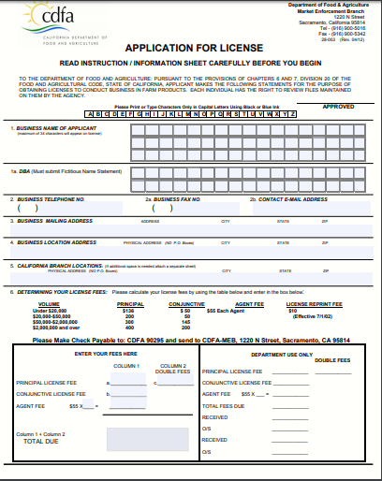
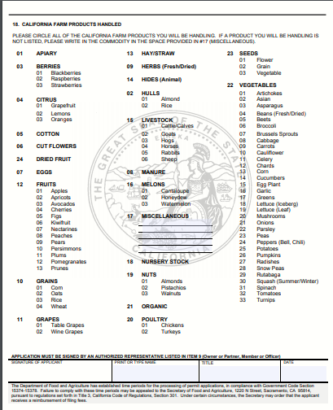
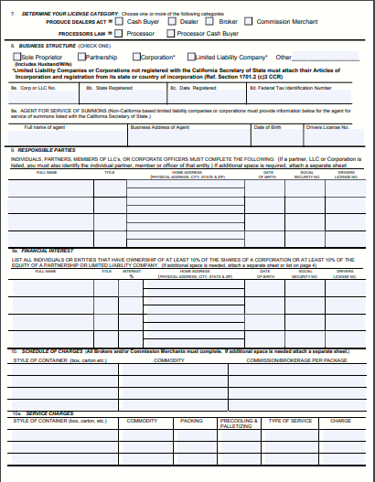
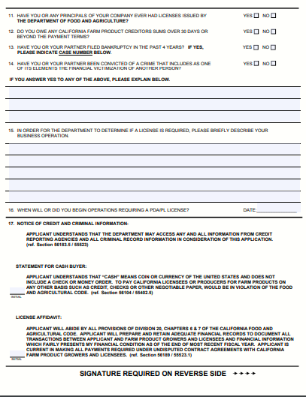
California Department of Food and Agricuture (CDFA)
https://www.cdfa.ca.gov/mkt/meb/Forms/28-003(Long_Form).pdf

Slide 29
BOE
Excise Tax Reporting
Due 15th of the month following the reporting month

Slide 30
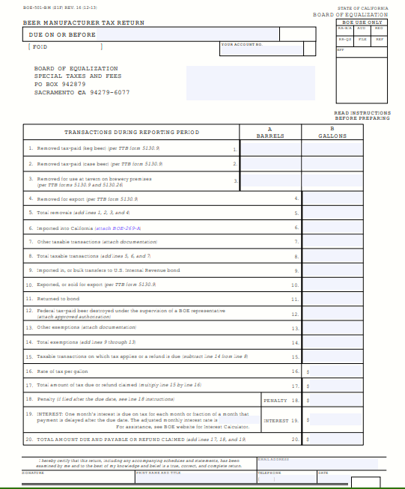
BOE
http://www.boe.ca.gov/pdf/boe501bm.pdf

Slide 31
It’s an adventure…

Slide 32
Filings/Reporting
FEDERAL

Slide 33
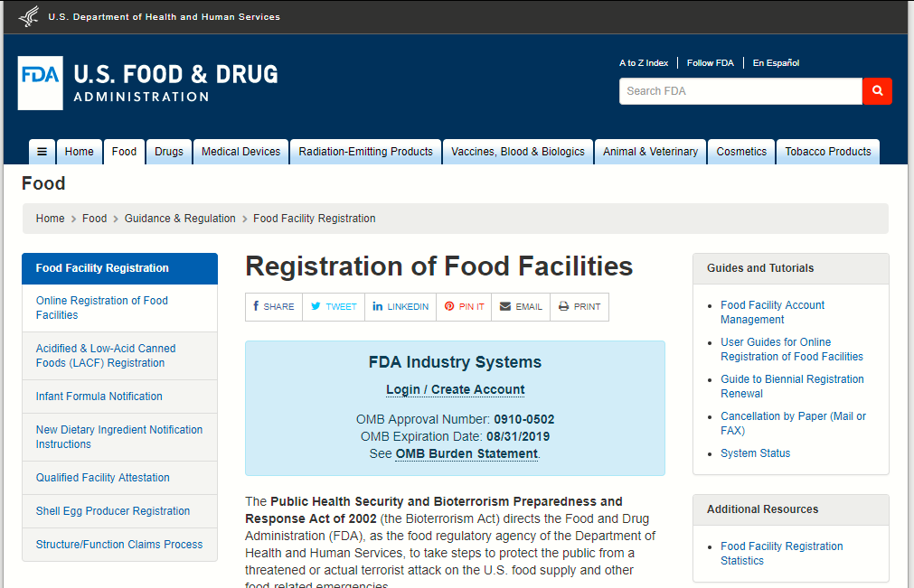
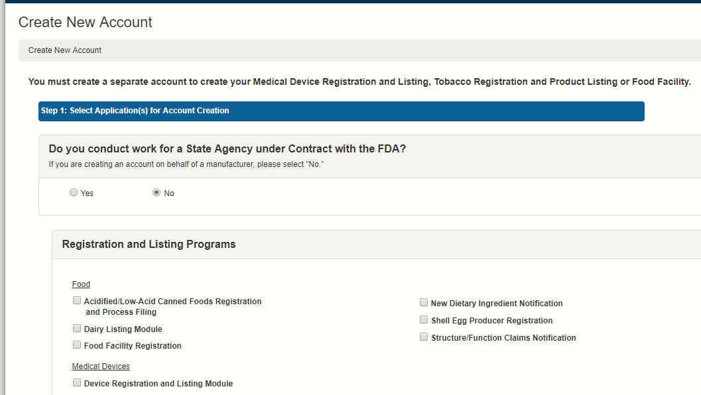
FDA Food Facility Registration
https://www.fda.gov/Food/GuidanceRegulation/FoodFacilityRegistration/default.htm

Slide 34
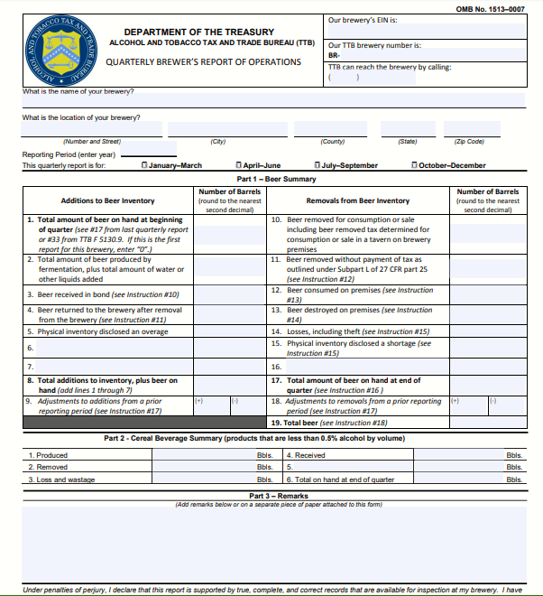
TTB Brewer’s Report of Operations
File quarterly if: You are liable for not more than $50,000 in beer federal excise tax in the previous calendar year, and You reasonably expect to be liable for not more than $50,000 in such taxes in the current year. Due 15th of the month following the end of the reporting quarter

Slide 35
TTB Changes after original qualification
Address (No change of location) Addition of Trade Name Alternation of Premises Bond Amount Bond Renewal Construction Contract Brewing Control | Deletion of Trade Name Discontinuance Entity name Extension or Curtailment of Premises Location Officers/Directors/Stockholders Proprietorship

Slide 36
fauna@craftbeveragecompliance.com 562.666.5837
Questions?

Slide 37
You’ve got a friend, or two, or three… or four hundred fifty...

