Slide 1
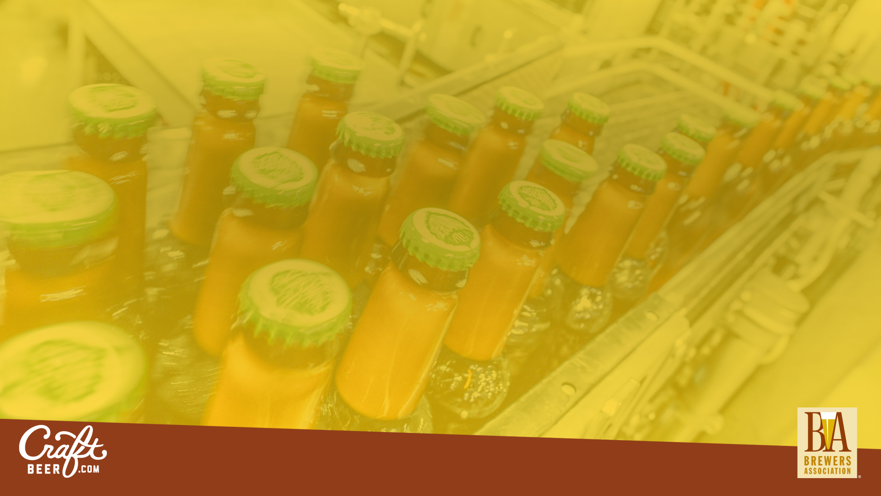
Marketing & Branding Differentiation in a Competitive Market
Julia Herz | Craft Beer Program Director | @HerzMuses
Notes:
Talk Title: Marketing & Branding: Differentiation in a Competitive Market
Talk Description: Join Julia Herz, Craft Beer Program Director at the Brewers Association and Publisher of CraftBeer.com, as she provides practical tips on how to build your brand, earn customers and influence beer lovers. In this session she’ll cover everything from marketing 101, social media strategies, successful practices used by multiple craft brewers and how to ensure you gain top of mind awareness in a busy beverage world.
Today I have an opportunity to ground us, align us and rally as I remind…
How legislative challenges should not deter the brewer business spirit. We are seeing many successes and advancement in Texas. This group of attendees should be commended for chipping away at the wall that slows down your brewery businesses. Overtime we are seeing that perseverance and dedication pay off as Texas is more and more becoming a beer destination.

Slide 2
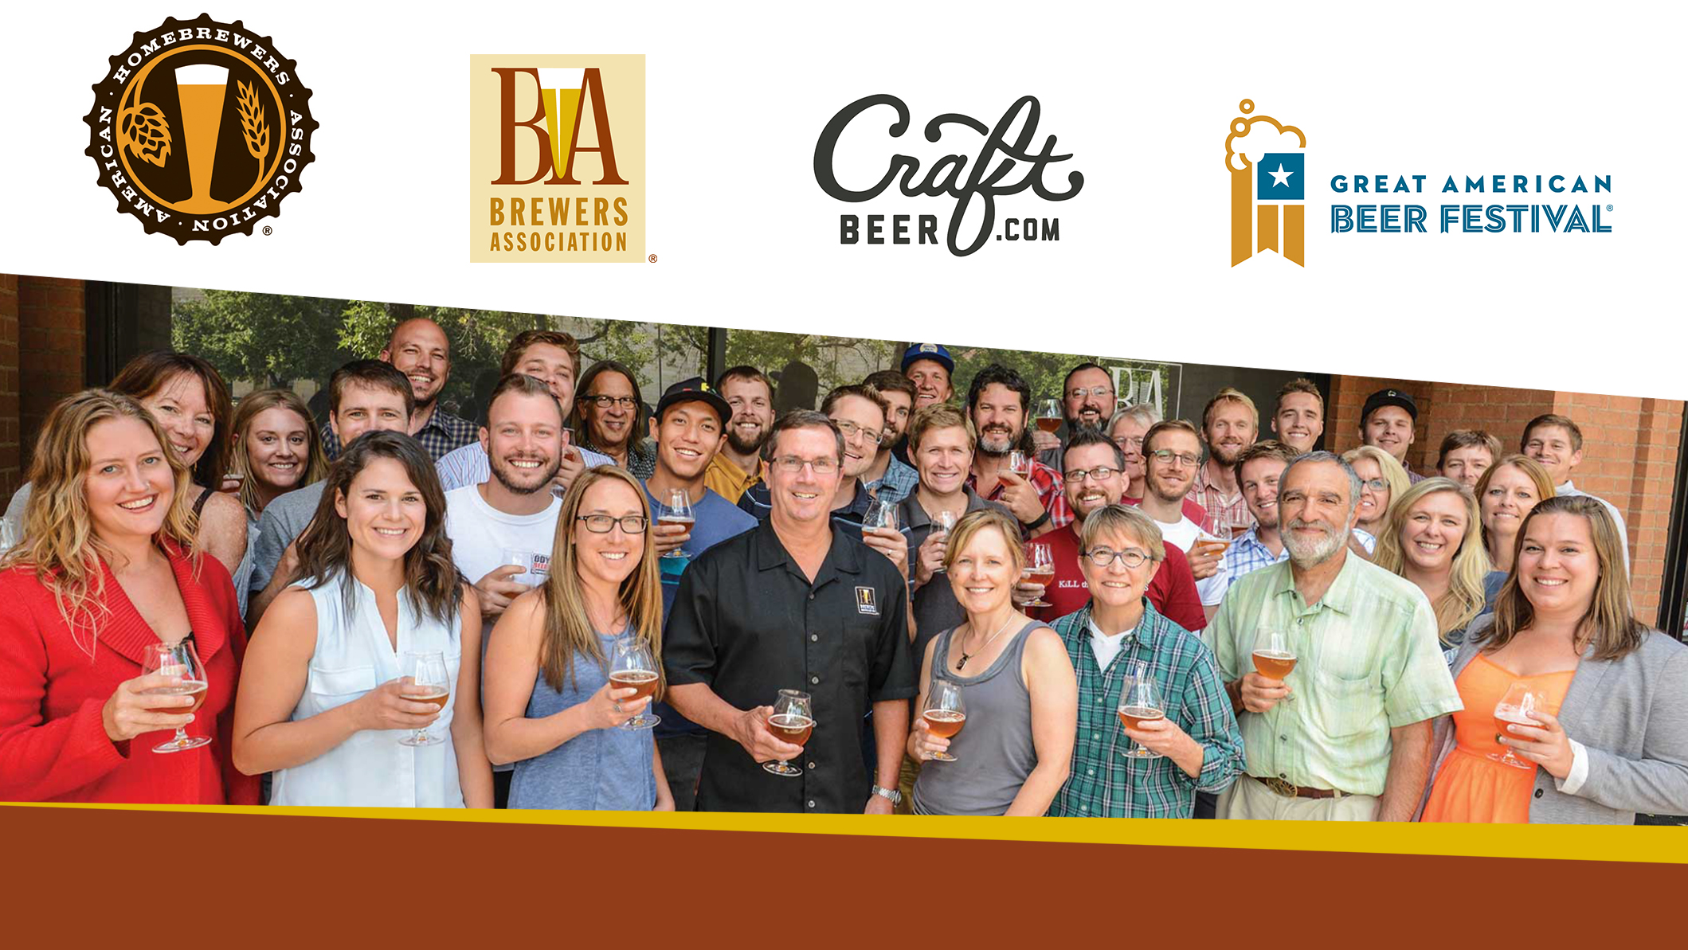
Brewers Association Boulder, Colorado
Notes:
Great group, passionate – turn-over is very low.
60 estimated employees.
National not for profit trade group representing the majority of U.S. breweries.

Slide 3
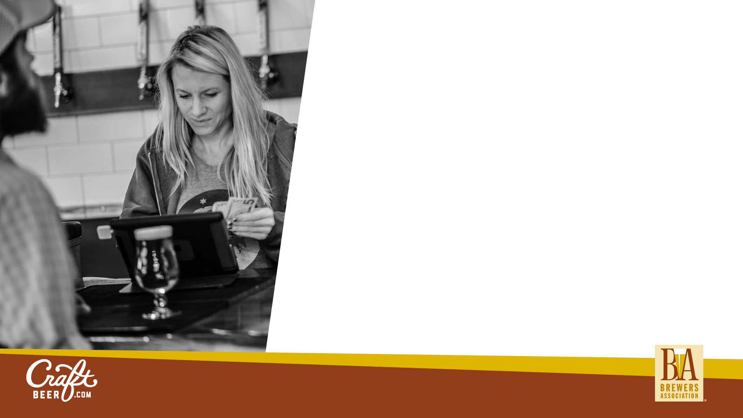
Brewers Association Membership
50K+ MEMBERS
70%+ of 5,300 U.S. Breweries
Retailers, Wholesalers, Allied Trade and Homebrewers
Adding Educational Institutions
Like the James Beard Foundation for Beer…but more.
Promote and Protect
Notes:
Our members are passionate and connected
Just like your guild we need your membership.

Slide 4

Areas of Emphasis
Promote and Protect
Ingredients
Craft Beer Program
Festivals
Federal
Quality
Books
Grow
the Hobby
Competitions
States
Sustainability
Magazines
Conferences
Guilds
Safety
EDP
Technical
Educational
Programs
AHA
Events
Government Affairs
Notes:
As long as a brewery can differentiate and make world class beer they will succeed.
As an advocate and educator speaking on behalf of craft brewing I’m very invested and dedicated in seeing craft brewing and demand grow.

Slide 5
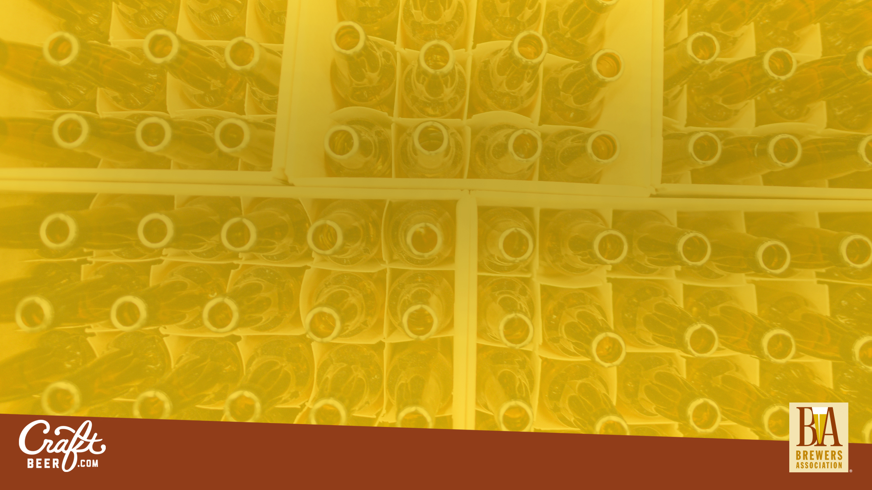
U.S.
Beer Market

Slide 6
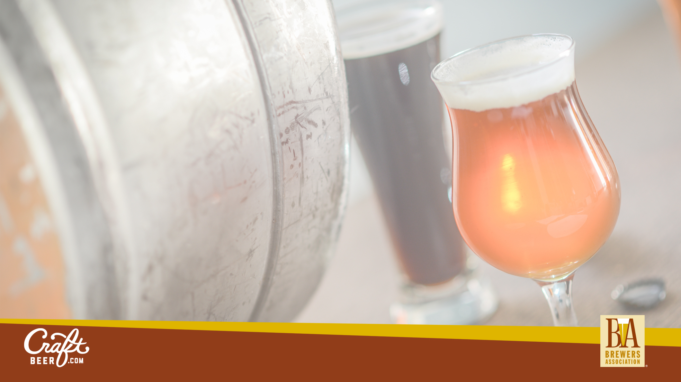
The U.S. is the #1 destination for beer on planet earth.

Slide 7
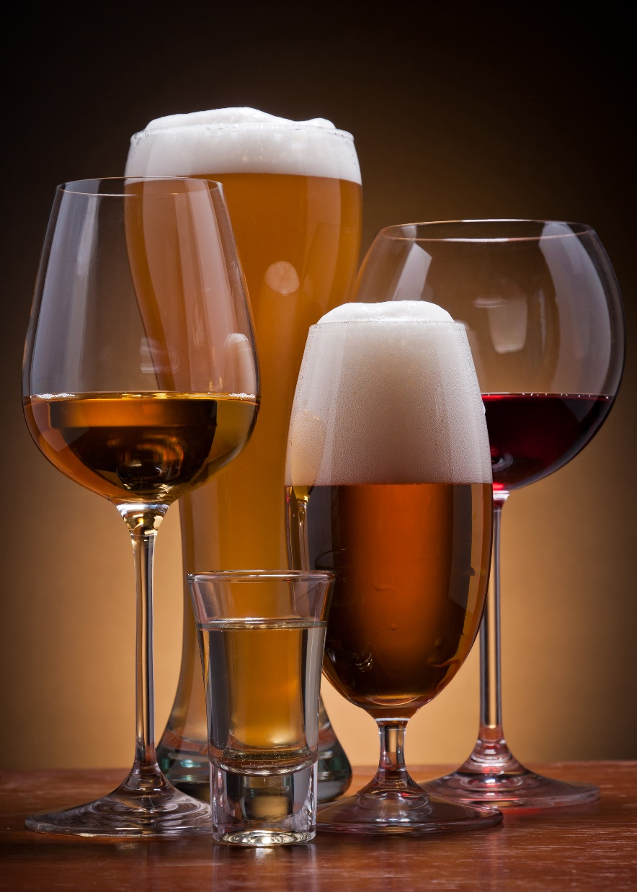
Alcoholic Beverage Sales
U.S. MARKET
Category | Sales in billions
BEER* | $107.6 (2016)
SPIRITS | $69 (2015)
WINE | $50 (2015)
*$23.5B for Small and Independent Craft Brewers
Notes:
In the U.S. Beer contributes 1.5% Gross Domestic Product
22.3B up to 23.5B

Slide 8
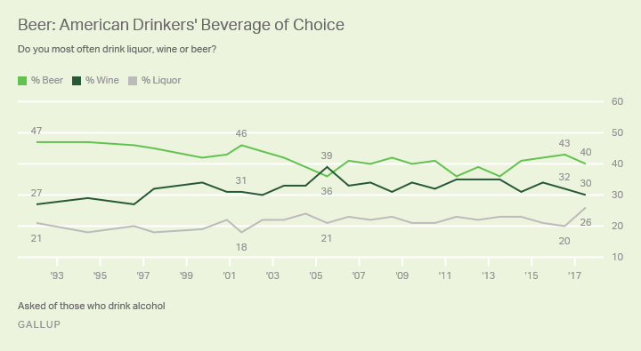

Slide 10
# of Breweries
5,600+
Nearly 1,000 cities with a population of more than 10,000 don't have a local brewery YET.
Notes:
As long as a brewery can differentiate and make world class beer they will succeed.

Slide 11
How important is “local” in purchase decisions?
Source: Nielsen Quick Query Omnibus Survey, 12-17, 2015. (Base: LDA consumers who drink at least several times per year)

Slide 13
Notes:
Ballast Point: 430k bbls
Constellation: 18.125M bb
Heineken USA: 8.4M bbls
Lagunitas: 921k bbls

Slide 14
Marketing
Notes:
The action or business of promoting and selling products or services, including market research and advertising.

Slide 15
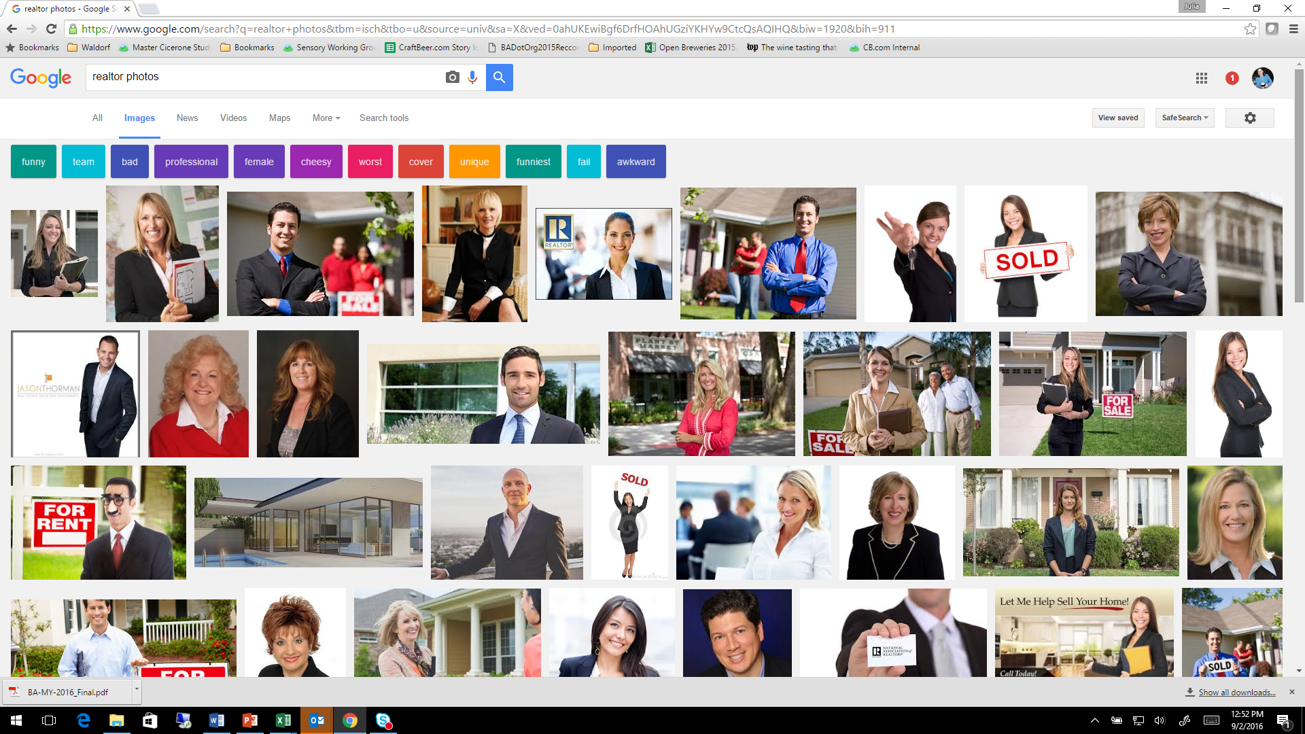
The Realtor Model of Marketing
Comfort leads to confidence. Confidence leads to sales.

Slide 16
Opportunities
Your brewery makes the world a better place
Your beers help make people happy
You help beer reclaim its place at the dinner table.
Your beers help support the community
Your jobs feed the tax base and fuel the economy.
You are a small business bright spot!
Notes:
You Are Marketing BEER!

Slide 17
Opportunities
Logo
Tag Line
Press Releases
External Communications
Labels
Notes:
As long as a brewery can differentiate and make world class beer they will succeed.
1 in 4 consumers do not know what they are drinking beforehand - Nielsen CGA On Premise User Survey (March-April 2017) – sample size: 15042

Slide 18
Opportunities
Tag Line: What is it?
Do your customers say it?
Does it get pick up?
Notes:
America’s Oldest Brewery
For the Love of Beer
Off-Centered Ales for Off-Centered People

Slide 19
Content
Evergreen Planned
Everyday On-The-Fly
Venues
Websites
Social Channels
Newsletters
Blog Posts
Notes:
Realize it or not but content is one of your products. You produce it right? So how much planning does it get? Even though it’s not paid for by your customer directly it does help pay the bills.
Just like one of a resteraunts ‘products’ is their experience. Right? They don’t sell the experience they sell food and beverage but …
All about grassroots, straight from the source message reach.
Strategy, Tactics, Execution, Nurturing
What are you marketing? Your story.
Content comes in a lot of forms:
Online
Social, videos, graphics, microsites
The entire face of advertising is changing as brands are becoming focused on how best to interest consumers. It’s less about making sure their logo is on every piece of material and more about how to provide information (and generate conversations) with consumers. Brands are spending less on “Traditional advertising” and more on content that people are truly interested in and want to engage with and hopefully share as well (the viral aspect.)
The Beer and Food Course is a terrific example of this. People are coming to us because we’re a valuable resource for engaging, interesting and informative content. We could advertise all day long that pairings are important, but what we’re doing is providing them tools and resources. It’s not about (in this case) making them care about the BA or CraftBeer.com, but having them takeaway the bigger picture we’re trying to communicate.
And
Planned (Editorial calendar or in a schedule) and real-time (on the fly)
=====
Evergreen
Beer Styles, Beer 101, CB.com Beer and Food Course
Product Description pages. OWN it. Be the leader in information on your brand. Be the authoritative source.
51% of our audience is mobile – Responsive design
Produce
Package/Publish
Promote (and then re-promote)
Always seek out engagement
Engaging headline
Poll at bottom of post
Ask a question
Conversational
The art of the infographic:
Informative
Easy to read
Branded
Shareable
30/30/30 rule: <Via your content marketing>
Talk directly about your organization and related content
Spotlight others
Reflect on the values of your organization to entertain and engage
Photos-behind the scenes / Food porn
If the #1 goal of Twitter is to drive people to the website then the most important metric is the click-through rate and seeing how many people come from Twitter to the site via Google Analytics Social metrics. Engagement and shares are great and increasing those can lead to more click-throughs, but the top metric I feel is the actual conversion from a Twitter follower to a website visitor.
As far as engagement rate is concerned over the years I would say for larger brands is 2 – 5% is considered really great. The average from 2012 – 2014 was only around .5 – 1% but lots of companies and organizations do not use Twitter correctly. I would set the bar a little higher once you are really using Twitter strategically and aim for between 5 – 10%. You have a really great audience so I am hoping the engagement rate could climb even higher, but if we look at what the majority of companies and organizations achieve it is not very high. In the strategy I will address this questions in more detail.

Slide 20
Word Of Mouth
The highest value
How do you speak to your champions?
How do you speak to those new to you?
What do your customers say about you?
Notes:
On-premise: Craft brewers have helped beer reclaim its place at the dinner table and are in demand to be offered on restaurant menus.
At the brewery = 3rd channel (Nielson).

Slide 21
Public Relations
Media Advisory
Press Releases
Press Statements
Transparency
Notes:
Is Your Brewery Leading the Conversation?
You have a VOICE
New statistics: Jump on that
Media story published: Add your voice
New beer releases: Be the main authority on brand details.
May hay of your milestones:
Xxx flight, pint, keg, pairing meal SOLD
Xxx tour given
Xxx birthday of customer celebrated
Xxx accounts carry the beer
Xxx barrel of beer brewed
Xxx out of state visitor
Xxx donation to charity
xxx

Slide 22
Differentiation

Slide 23

U.S. Craft Brewer Defined
Small
Independent
Traditional
99% of today’s 5,300+ U.S. breweries
Notes:
12% by volume
Big 2 = 69%
Imports and others Pabst

Slide 24
AWARENESS LEVELS (percentage across 29 terms)
LOWEST
AVERAGE
HIGHEST
19%
52%
81%
GABF
Independent/ Independently owned
Brett
Funky
Grassy
Mosaic
Traditional
Hoppy
Drinkable
Limited edition
Nielsen study conducted by the Harris Poll (May 19-23, 2017)
Q: How familiar are you with each of the following terms as they relate to beer?

Slide 25
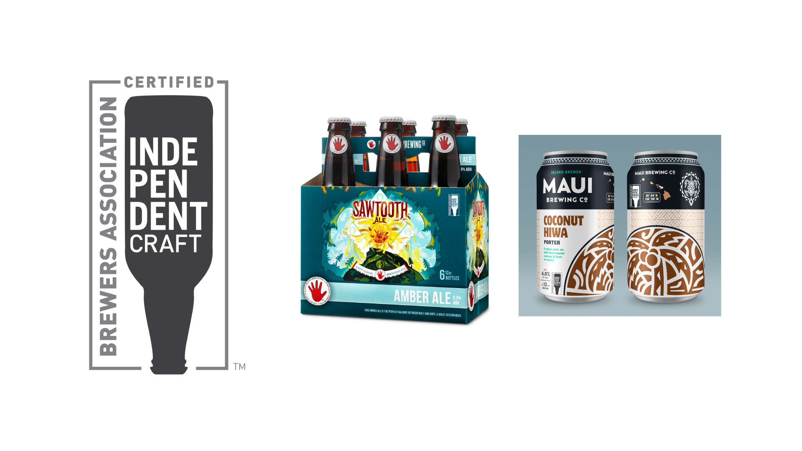
Independent Craft Brewer Seal
BrewersAssociation.org/seal
Differentiation

Slide 26
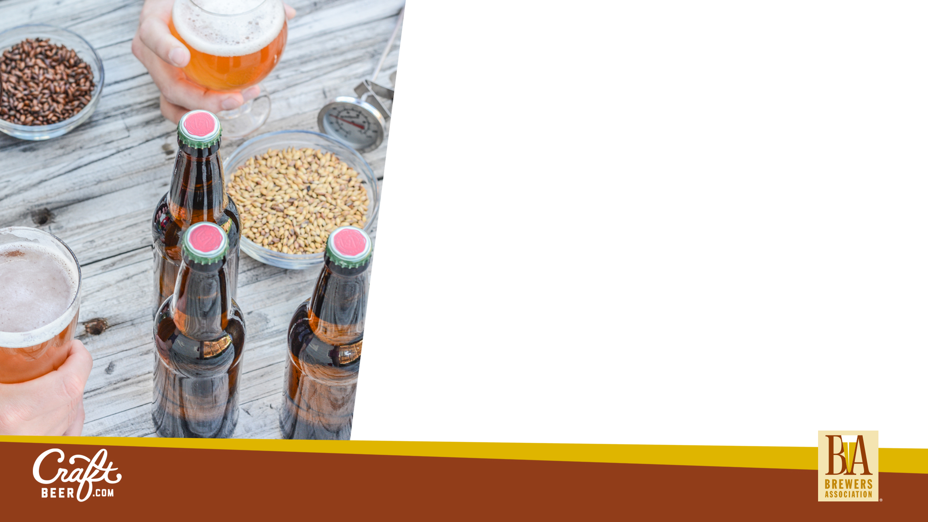
Homebrewing in U.S.
1M+ homebrews
1,500+ Clubs
700+ Retailers
BJCP Competitions 626 in 2015 vs. 192 in 2003
46,000 members of AHA
HomebrewersAssociation.org
Notes:
AHA membership 46,000, compared to 8,500 in 2003

Slide 27
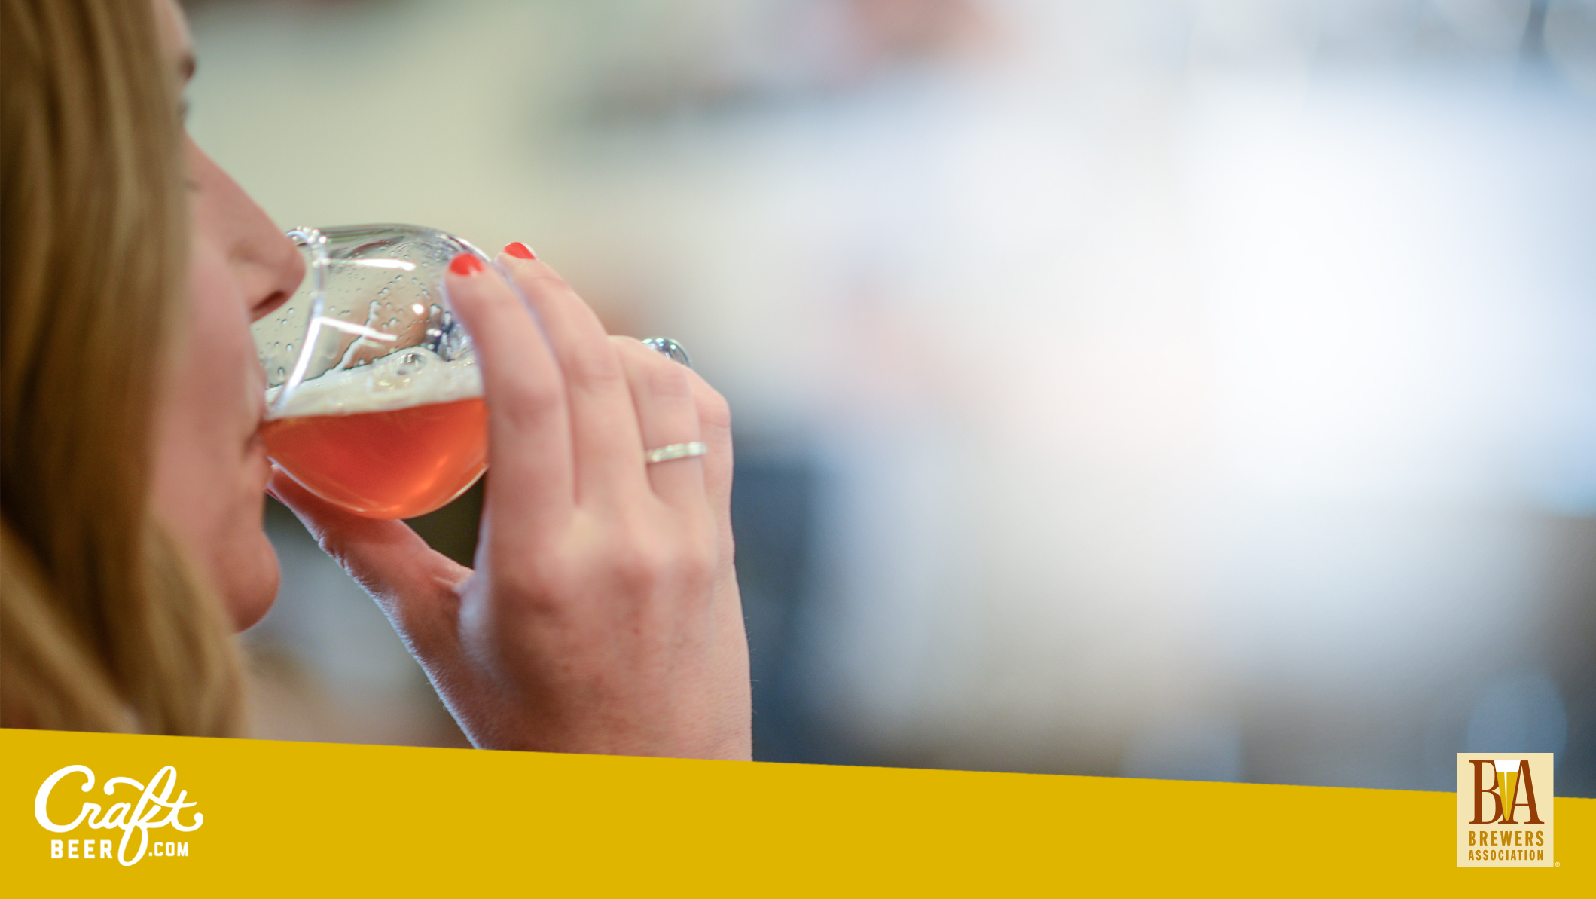
Types of Beer Lovers
Beer Beginners
Beer Enthusiasts
Beer Geeks
Notes:
Data on ‘craft beer’ is not guaranteed. Thousands of breweries not included.
Usually ‘self identified’ since craft beer is NOT defined.

Slide 28
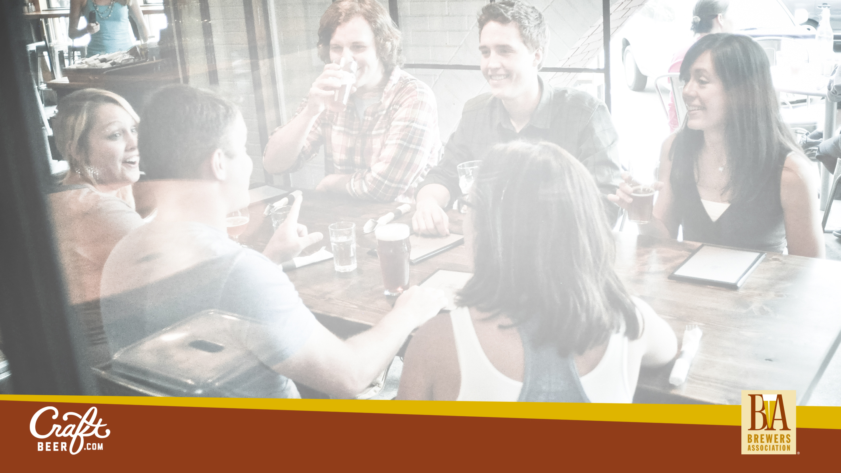
Gender of U.S. Beer Lovers
72% Male
28% Female
Source: 2016 U.S. Yankelovich MONITOR survey, which tapped more than 10,000 respondents
Notes:
Craft beer female numbers are similar depending on whose data you are looking at, but since the data is often skewed (craft data includes Shock Top, etc) we are not definitive.

Slide 30
Total Beer vs Craft Age Breakdown
CRAFTS (incl DM SPECIALTY) – AGE/GENERATIONS; Index to % Adults
AGE 21+ | % Adults | TTL BEER |  | CRAFT*
 |  | % Volume | Index | % Volume | Index
21-34 | 25.6% | 35.1% | 137 | 35.5% | 138
35-44 | 18.0% | 20.7% | 115 | 24.3% | 135
45-64 | 37.1% | 33.3% | 90 | 31.6% | 85
65+ | 19.2% | 10.8% | 56 | 8.6% | 45
<80
>120
Source: Nielsen Spectra /Simmons (Data Version: Sept 2014); on plus off-premise
Notes:
Over index: When something is performing better than what that thing is being measured against.

Slide 31
Dissecting Craft Data
On vs off premise different animals
Hundreds if not thousands of breweries sales often not included for ‘craft sales’.
Craft does not mean same craft to everyone. So qualify.
Notes:
Our members are passionate and connected

Slide 32
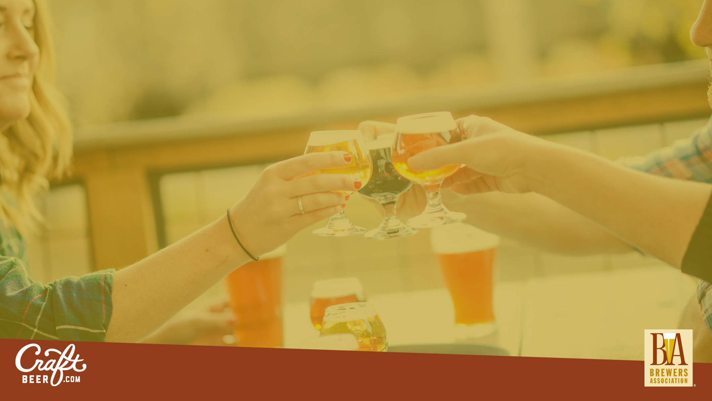
Opportunities

Slide 33
Sales
 | S&I Craft Beer | ALL Beer
ON-PREMISES | 27% | 18%
OFF-PREMISES | 64% | 82%
AT THE BREWERY | 9.2% | <1%
Notes:
On-premise: Craft brewers have helped beer reclaim its place at the dinner table and are in demand to be offered on restaurant menus.
At the brewery = 3rd channel (Nielson).

Slide 34
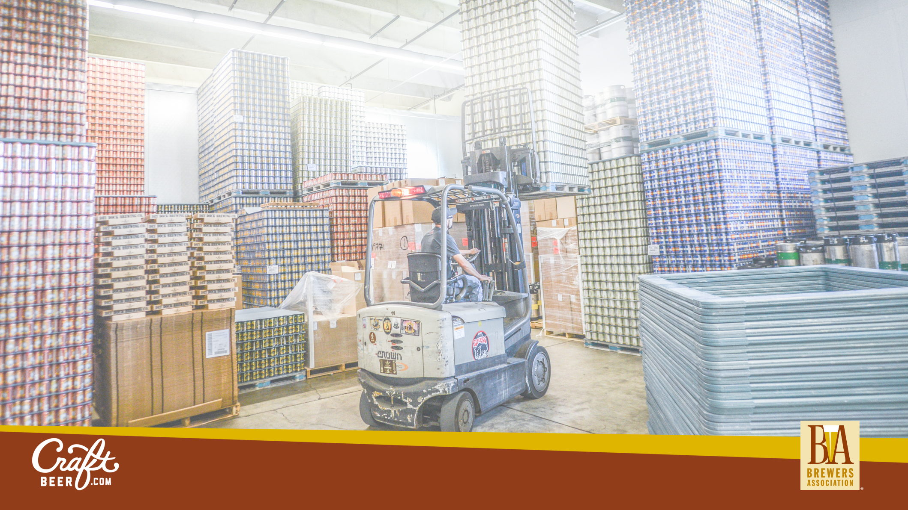
Pairing Potential
 | S&I * | Overall Beer**
Bottles | 60% | 34%
Draught | 30% | 10%
Cans | 10% | 55%
Splash in the glass
½ glass
*2014 Brewers Association Brewery Operations Benchmarking Survey (BOBS)
**NBWA 2016

Slide 35
Consumption of craft beer is biased toward eating occasions
% drinking craft beer for occasion type
Food-led occasions
Drink-led occasions
31%
49%
20%
Q: On which occasions do you typically drink craft beer?
Source: Nielsen CGA On Premise User Survey (March-April 2017) – sample size: 3082

Slide 36
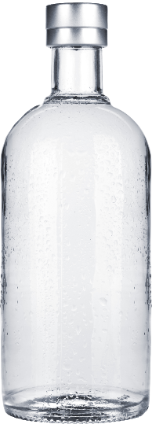
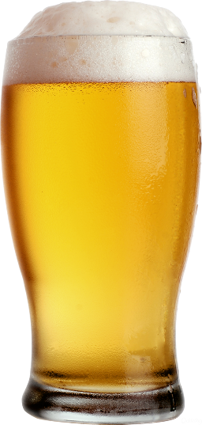
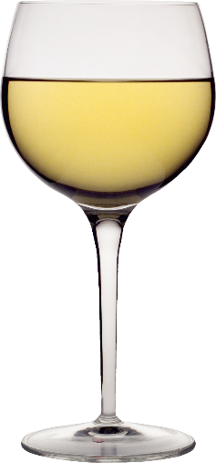
Influencing factors behind category choice out-of-home
While quality and availability is paramount for all drinkers, the time of day is more influential for spirits drinkers than for beer and wine drinkers
Beer
Wine
Spirits
1) | The quality of beer brands available | 40%
2) | Price | 38%
3) | The availability of my favorite beer brand | 36%
4) | The type of venue I am at | 27%
5) | Time of day | 26%
1) | Price | 41%
2) | The quality of brands available | 37%
3) | The availability of my favorite wine style/brand | 37%
4) | The type of place I am drinking wine at | 35%
5) | Suggestions for food pairing | 28%
1) | The quality of spirits brands available | 34%
2) | Price | 34%
3) | The availability of my favorite spirits brand | 31%
4) | Time of day | 30%
5) | The type of venue I am at | 30%
Source: Nielsen CGA On Premise User Survey (October – November 2016) – sample size: 6814, 5083. 6574

Slide 37
Samples Matter
71 percent of guests who request a sample of a beer go on to order a full-sized pour of the same beer.
Guest checks that contained at least one sample had a 35 percent higher craft beer sale than those without a sample pour.
  - Tim Brady, Whetstone Station Restaurant, Brewery & Bier Garten, BA Brewpub Committee
Notes:
https://www.brewersassociation.org/articles/the-value-of-fractional-pours/
by Tim Brady of http://www.whetstonestation.com/
Brattleboro, Vermont.
Two year study: implemented a system to track sample pours. We continued to offer one-ounce samples at no cost, but asked staff to start entering them into our point-of-sale system. Over the course of two years, some interesting data has emerged.

Slide 38
Closing Thoughts

Slide 39
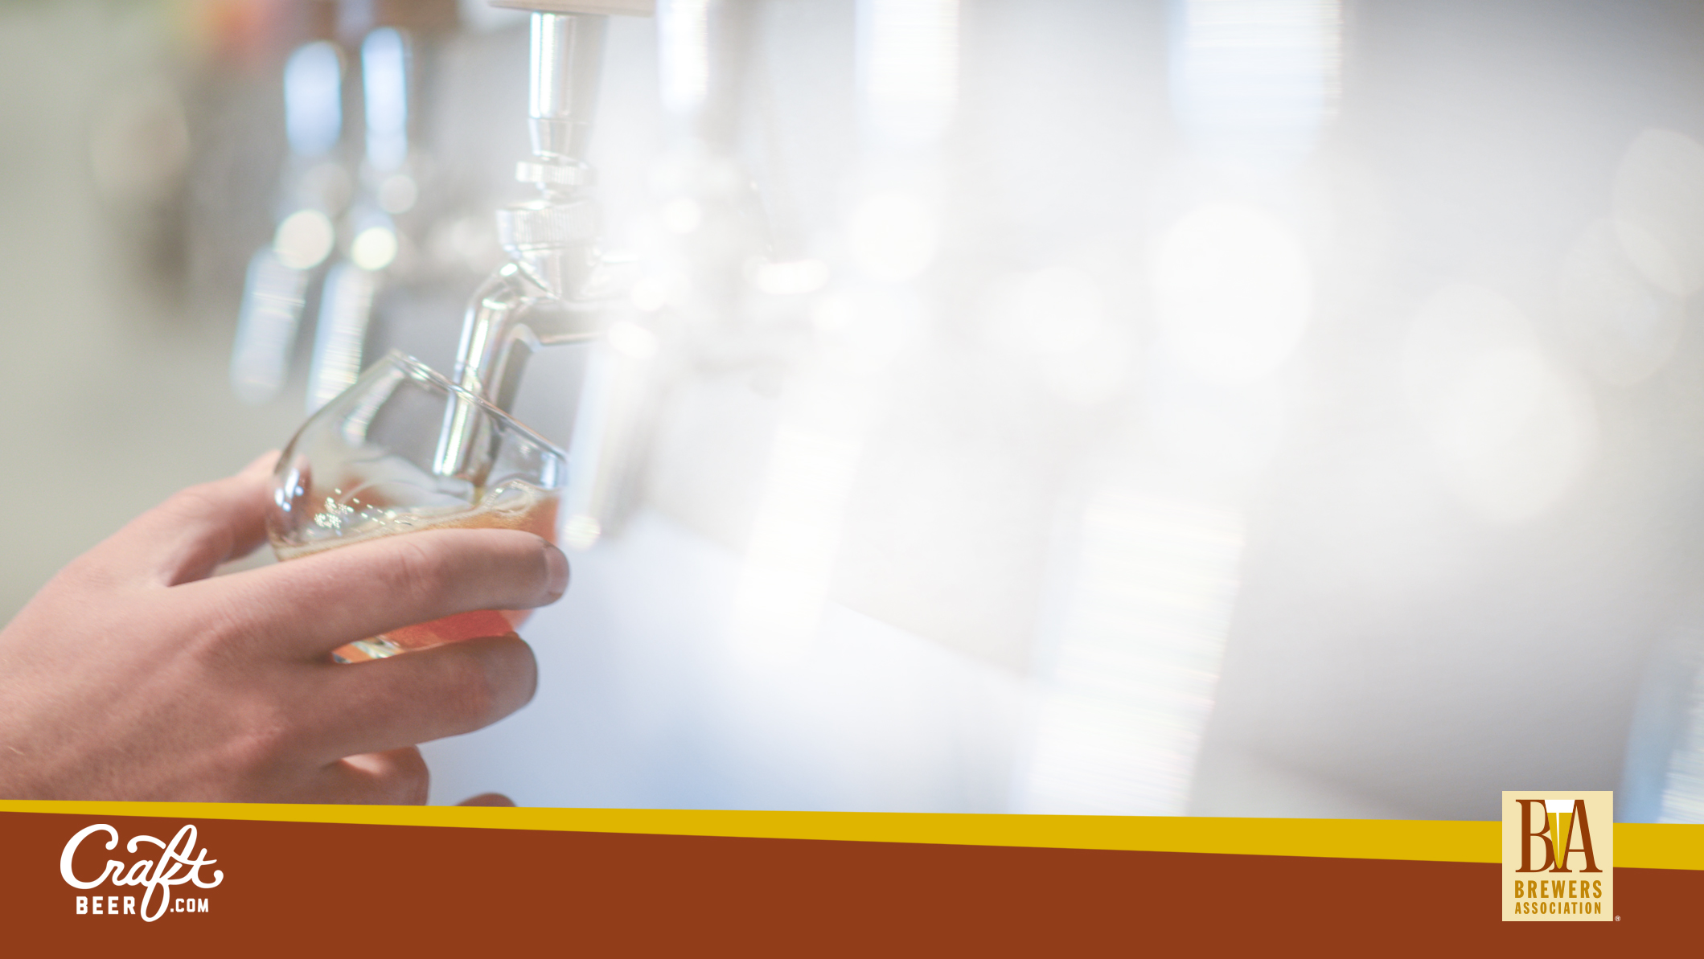
Strategy
Brew world-class quality beer
Attract (and retain) talent
Investment in sales, media relations, marketing and Government Affairs.
Continue to innovate
Lead in pairing
Differentiate don’t denigrate
Notes:
Fair access to market for all U.S. breweries
No one brewery owner should become the “one stop shop” for beer
“Consumer choice, not producer power, should determine what beers go on the truck.” - Senator Klobuchar (MN)
Continued growth and demand for our members beers.
Our beer culture is now so advanced we have to watch out for it swinging back towards monopolies.
We don’t desire or deserve to see an illusion of choice where beer destinations only offer brands from one of the large two breweries.

Slide 40
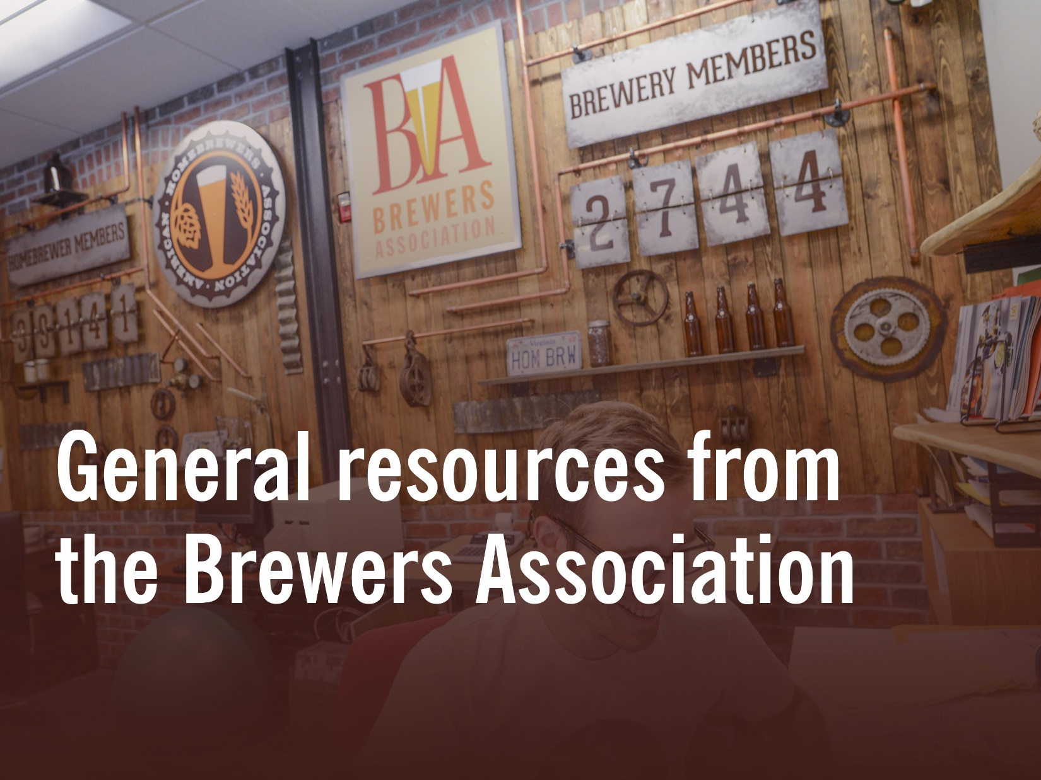
Notes:
Seasonal craft beer mailers
AHA Member Deals – 1,300
Statistics
$71M donations, 2014. $3.35 per bbl/$20K per brewery, ABInBev .35 cents per (yes magazine)
# Tours – 10 M people
Economic contributions - $24B / 105.9
121,000 full-part time jobs

Slide 41
What Is Quality?
"A beer that is responsibly produced using wholesome ingredients, consistent brewing techniques and good manufacturing practices, which exhibits flavor characteristics that are consistently aligned with both the brewer's and beer drinker's expectations.“
BrewersAssociation.org

Slide 42
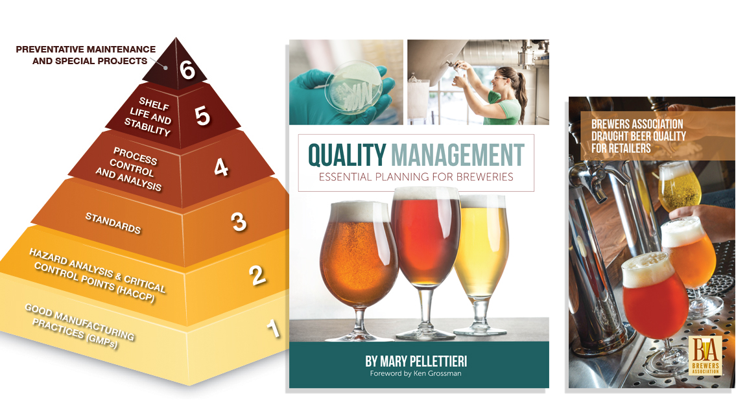

Slide 43
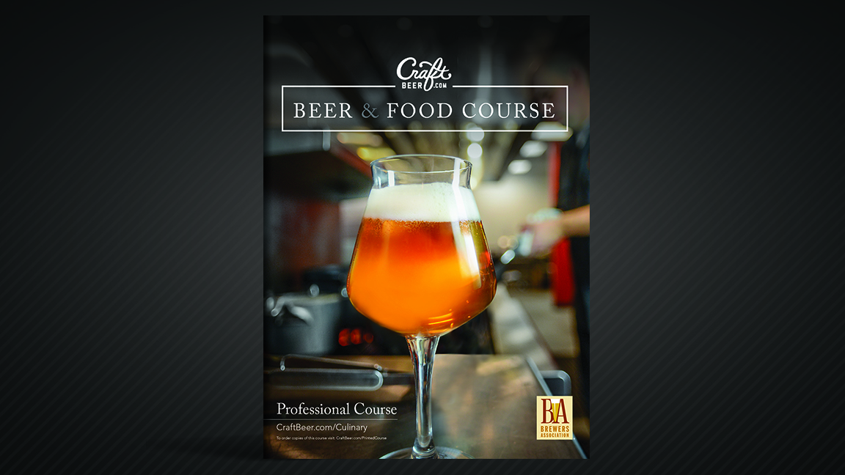
Beer & Food Course Cover

Slide 44
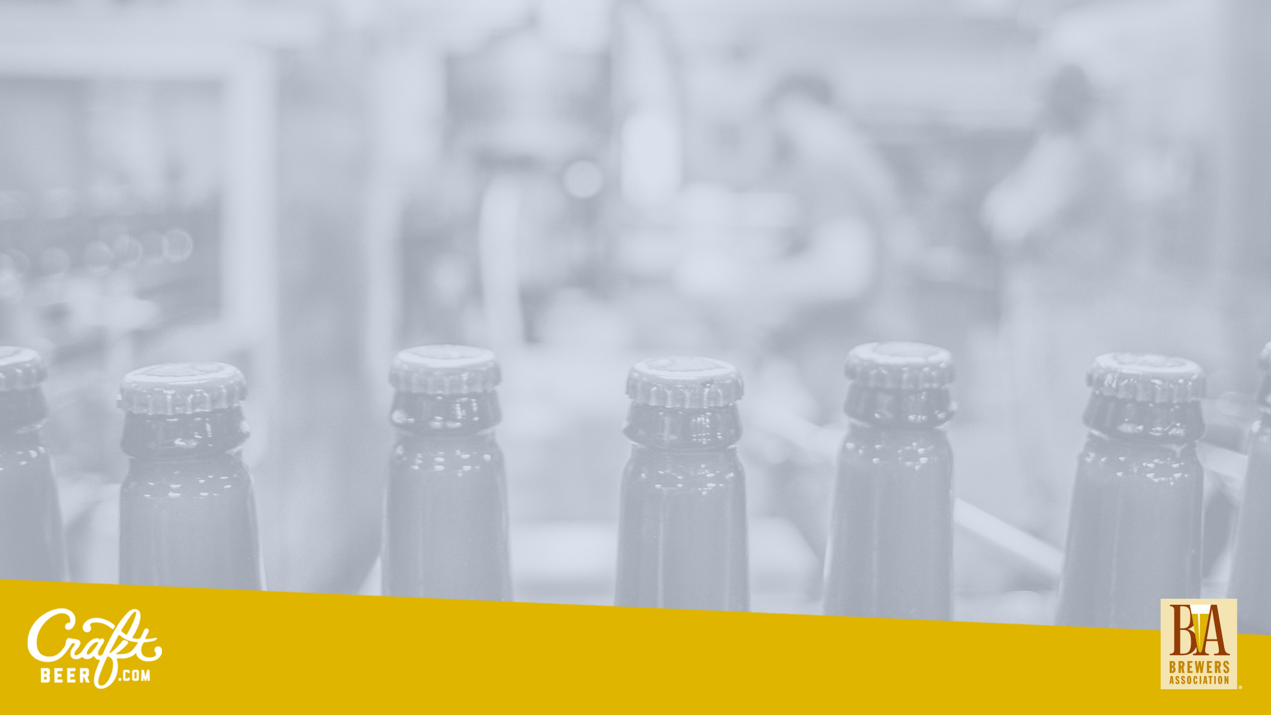
The Importance of Guilds
Notes:
50 + more
They represent the interests of the breweries in those states
Official guild events are what to nurture and support first and foremost.
Heather Sanborne – Rising Tide and Maine House of Representatives.
What are you most proud of regarding your past role with the Maine Brewers Guild?
“We worked to legalize tasting rooms in Maine in 2012, which transformed the state’s beer industry in a really positive way Maine became a world-class destination for beer tourism in a way that it never could have otherwise. – The New Brewer Magazine, March/April 2017.
2010 Maine had 23 breweries. Now more than 90.

Slide 45
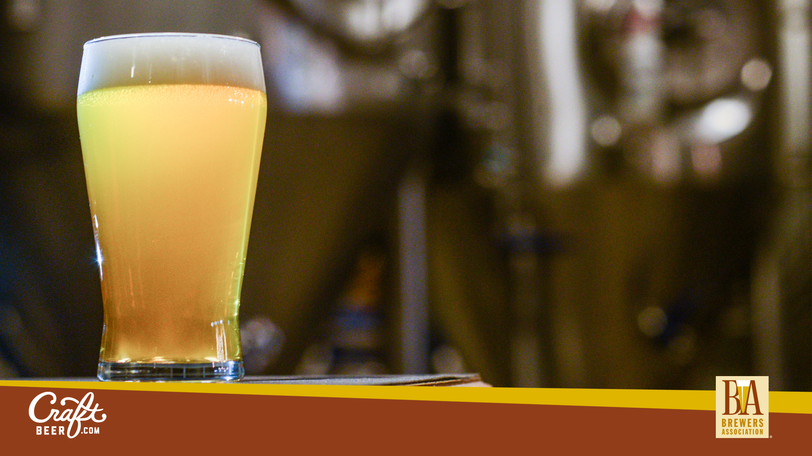
Thank You
Julia Herz | Craft Beer Program Director | @HerzMuses

