Slide 1
Consumer Sensory Research for Craft Brewers
November 6, 2017

Slide 2
What is Sensory & Consumer Science?
Sensory Evaluation is a “scientific discipline used to evoke, measure, analyze and interpret reactions to those characteristics of foods and materials as they are perceived by the senses of sight, smell, taste, touch and hearing”.
The combined understanding of human behavior, the physiology of the senses as well as knowledge of experimental design and statistics are essential to obtaining actionable results and developing key recommendations.
Any developments/advances must follow the science ……

Slide 3
It seems so simple!
Product sensory information is unique; deceptively easy to obtain but can lack validity when the science is misunderstood or not followed.
A consumer agrees to taste a product and answer some questions about the experience.
A consumer participates in a discrimination test.
Consumers will agree to participate especially if you offer them a “financial” reward.

Slide 4
Why do so many products fail?
The sensory professional typically designs a product test using a small consumer population and then makes inferences to a larger population; i.e., predictive relationships.
However, not every “sensory” tests follows basic scientific methodology to understand the underlying patterns of consumer behavior.
A few common errors in sensory testing include . . .
1. The consumer was not qualified as a product user
2. The consumer was not qualified based on sensory skills (analytical testing)
3. The consumer was not representative of the target population

Slide 5
Why do companies support sensory programs?
Usually management needs answers to questions such as:
Do technological or ingredient changes impact consumer preference and purchase?
Hop source, temperature, seasonal ingredients, carbohydrate source, etc.
Which sensory characteristics most impact preferences and purchase intent ?
Sweetness, color, astringency, aroma, mouth weight.
What physical and chemical measures best represent important sensory measures?
Alcohol level, pH, bitterness units, etc.
Which new brews are best to go into a test market or retail space?

Slide 6
Sensory Resources Required
There are a finite number of resources to help provide valid and reliable research.
Subjects/Test Population
Methods
Facilities/Test Location
Gathering sensory information and data processing
Professional staff for research design, execution, and interpretation

Slide 7
Subjects Must Be Qualified
Defining the target consumer is necessary to ensure research integrity. Unfortunately, business decisions are often based on results obtained from an erroneous test population.
Anyone can participate in a sensory test by being at the right location at right time.
But ………………each individual’s sensory skills are unique.
Basic sensitivity can vary by as much as 100+%, among average or heavy/frequent product users.

Slide 8
Sensory Skills Vary Greatly in the Population
Sensory analytical tests are small panel procedures that rely on about 25 or fewer subjects so the qualifying process is critical.
But, about 30% of any population cannot discriminate differences between products at better than chance even among products they regularly consume.
Increasing N does not reduce error or correct for use of unqualified subjects.
Testing unqualified individuals increases risk of incorrect decisions (sometimes referred to as ß, beta risk, or type 2 error – stating there is no difference when, in fact, there is).

Slide 9
Best Practices Methodology
To account for variability due to subject’s sensitivity used in sensory analytical tests, we:
Use a panel of qualified subjects
Qualify subjects based on product use and sensory skill
Use balanced block serving orders
Require a response; i.e., tests are forced choice
Use repeated trials design
Monitor performance on a subject basis by and across tests

Slide 10
All Products Vary
A few comments about product:
All products are different from each other; a source of variability.
Brands and label information are influential. Products usually evaluated blind, without the benefit of brand and imagery to minimize halo/bias effects.
Some products are innately branded with embossed logos and other characteristics; e.g., chocolates, Oreo cookies, running shoes, and that limits the types of methods that can be used.

Slide 11
Categories of Sensory Methods
There are two types of sensory methods -- analytical and affective.
Analytical methods include discrimination and descriptive analysis
Affective methods include liking and preference
No method is more sensitive then another !!

Slide 12
Analytical -- Discrimination Testing
Objective is to determine whether the difference between products is perceived at a previously established level of significance.
By convention, we use α = .05 or the 95% confidence level.
Tests require a homogeneous population of qualified subjects (must demonstrate discrimination ability). A typical panel size is 25, but more or less can be used (an experimenter choice). Use of repeated trials is recommended.
Only measure whether a difference is perceived (a discrete or categorical judgment).
Paired Sample Test
Duo Trio Test
Triangle Test

Slide 13
Analytical – Descriptive Analysis
Objective is to describe products using a sensory language and quantify the intensities of the language.
A small panel procedure using ~12 subjects, all of whom are qualified based on their product usage and demonstrated discrimination skills.
The results provide visual displays or maps of products and their spatial relationships.

Slide 14
A Sensory Map (QDA Spider Plot)
Intensity is measured from the center to the end line for each attribute for each product.

Slide 15
A Sensory Map (QDA Spider Plot)
Intensity is measured from the center to the end line for each attribute for each product.

Slide 16
Affective -- Preference
Measure preference for one product vs. another.
Uses ~ 50+ consumers meeting test objective and demographic profile.
Consumers do not need to demonstrate discrimination ability, but must be users and likers of the product/category.

Slide 17
Affective -- Hedonic
Measures degree of liking for an array of products using a scaling system such as the 9-pt hedonic scale. An indirect measure of preference.
Recommended number of respondents ranges from not less than ~50, but often > 100 qualified consumers (product users, meet related demographic criteria).

Slide 18
Facilities
Most sensory tests use environmentally-controlled space to minimize non-test variables.
A facility will have:
- partitions to minimize visual contact between subjects
- partitions to minimize contact between subject and experimenter
- environmental & lighting controls
- separate prep area
- ease of access into/out of area

Slide 19
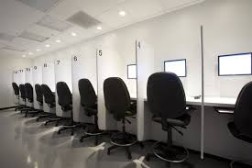
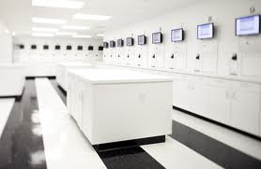
Typical Sensory Facility
Each sensory both is partitioned preventing respondents from interacting with each other during data collection. Data is collected by a computer/direct data entry system and the prep area has ample counter space.
Photos courtesy of Tragon Corporation, Redwood City, CA

Slide 20
Data Collection & Processing
Electronic capture systems (direct data entry) provide rapid and accurate response capture.
Real time analyses (cloud) and reporting; access to subject and product performance records.
Numerous systems available to best serve your needs and your budget.

Slide 21
Summary
Developing a sensory and consumer research program requires resources, qualified personnel, an operating strategy, and interaction with technology, innovation, quality controls, and marketing.
Successful programs develop actionable product knowledge that is easily understood by management and accepted as credible.

Slide 22
Let’s Taste Some Beer
Summer Shandy Beers

Slide 23
Sample Triangle Scorecard

Slide 24
Did You Select the Correct Product?
Sample 392 is the correct answer
Now, taste 392 and 393 again. Which ONE do you prefer?

Slide 25
Sample Preference Scorecard

Slide 26
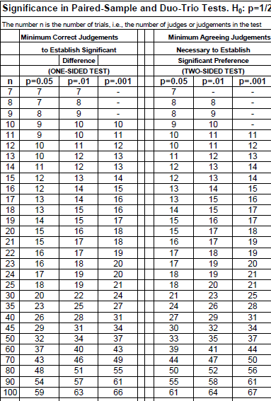
Analysis of Duo Trio and Preference Tests
Source: Amerine and Roessler Wines: Their Sensory Evaluation 1978

Slide 27
Category Sheet Introduction to Descriptive Analysis
Directions: Using your own words, write down terms to describe observations for each modality.
APPEARANCE AROMA
FLAVOR MOUTHFEEL AFTERTASTE

Slide 28
Descriptive Terms
Appearance |  | Aroma
Carbonated |  | Beer
Cloudy |  | Grapefruit
Foamy |  | Other Citrus
Golden Color |  | Other Fruit
Orange Color |  | Stone Fruit
Pink Color |  | Sweet
Thick |  | Texture & Mouth Feel
Flavor & Taste |  | Carbonated
Beer |  | Puckering
Ginger |  | Thickness
Grapefruit |  | Tingly
Other Citrus |  | Aftertaste
Other Fruit |  | Beer Aftertaste
Stone Fruit |  | Bitter Aftertaste
Tart |  | Fruity Aftertaste
Bitter |  | Grapefruit Aftertaste
Sour |  | Lingering Aftereffect
Sweet |  | Mouth coating Aftereffect
 |  | Sweet Aftertaste
 |  | Tart Aftertaste
 |  | Tingly Aftereffect

Slide 29
Application of Sensory Methods
Grapefruit Radlers: A Case study

Slide 30
Introduction & Overview
Shandy or Radler Beers are a summertime favorite in Germany and growing in popularity in the USA as a lower alcohol alternative beverage.
While imports can be found in many retail stores, American products are moving from the tap to the bottle. As brewers begin to develop products, research blending sensory science and consumer insights can provide an in depth exploration of consumers and products providing insights that can be used to create unique products that marketing can distinguish on shelf.
Sensory research can ensure that consumer expectations are met and identify meaningful segmentation.
Major challenges for any product category include:
Market strategy – customer profile, communications, positioning, and pricing.
Product strategy – ingredient source, processing, packaging, and sensory characteristics.

Slide 31
Research Objectives
Determine which products are well liked by consumers and why
Determine if preferences are different between markets
Determine sensory similarities and differences
Determine which sensory attributes provide product differentiation

Slide 32
How do we measure consumer perception?
QDA® was the methodology used to measure sensory similarities and differences between products for the array of Radler and Shandy products. This quantitative data is used to relate consumer preferences and attitudinal expectations to the perceived sensory properties of the products.
QDA® is a sensory trained panel procedure in which about 12 panelists, with demonstrated sensory acuity, describe and quantify their product perceptions using common everyday language.
Results are used to understand the “why” consumer like what they do and to discover new product opportunities.

Slide 33
Why is this important?
Measuring what consumers perceive about product similarities and differences has market and technical value.
But, the greater value rests with ...
relating sensory differences to consumer preference, attitudinal measures, benefits, brand, price/value, etc.
Sensory research provides strategic insight to market potential.

Slide 34
Products Tested
Lubzer Grapefruit Biermix
Leinenkugel's Grapefruit Shandy
Bavaria Radler Grapefruit
Schöfferhofer Hefeweizen Grapefruit Bier
Stiegl Radler

Slide 35
Quantitative Descriptive Analysis
A Sensory trained panel methodology

Slide 36
Descriptive Analysis Methodology
Qualified consumers evaluated 5 commercially available Radler and Shandy products using common everyday language.
The panel developed 36 sensory attributes to describe the products
7 Appearance
7 Aroma
10 Flavor & Taste
4 Mouthfeel
9 Aftertaste/Aftereffect
Products were evaluated 3 times to provide sufficient data for analysis.

Slide 37
Select QDA Attributes
Mapping the sensory attributes provides a visual display of the product and it’s fingerprint is revealed.

Slide 38
Product and Sensory Attributes
Appearance:
Pink, Orange, Carbonated
Visual display of attributes that define products.
Leinefugeals was not well liked and was associated with Bitter Taste, Sour Taste, Mouth Coating, Lingering Aftertaste, Tingly and Puckering Feelings.
Mouthfeel & Aftertaste:
Puckering, Tingly
Sensation, & Bitter
Aroma & Flavor:
Sweet, Other Citrus, Fruity,
Other Fruits

Slide 39
Consumer Assessment

Slide 40
Consumer Qualification Criteria
Approximately 150 consumers from San Francisco and Munich, Germany participated in this research and were qualified based on the following criteria:
Gender: 70% males, 30% females;
Ages 21-44;
Attended or graduated from college;
Purchased and regularly drink Radler or Shandy beer during the summer months;
Standard employment, allergies, pregnancy, and past participation screen.

Slide 41
Methods and Product Scorecard
Products were served blind, identified by a 3-digit code.
Serving Temperature Controlled
Serving Orders Were Balanced (Each Product Seen In Each Of 5 Tasting Positions)
Completed A Scorecard While Tasting The Product
Timed Intervals Between Products Helped To Maintain Sensory Acuity
Scaled Questions:
Overall Liking (9 point scale)
Purchase Interest (5 point scale)
Attribute – Just About Right Questions ( 5 point scales)

Slide 42
Central Location Test
Consumers in CA and Munich liked Bavaria and demonstrated strong agreement by ranking most brands similarly.
Least like by all consumers was Leinenkugels Shandy.

Slide 43
Understanding the ‘Why’ in Consumer Preferences
Combining QDA & Consumer Assessment Results

Slide 44
Relationships of Sensory Attributes and Acceptance Single Correlations
Consumers reacted positively to Radler products that had higher levels of sweet, fruit and citrus flavors. They also disliked products with high levels of bitterness and puckering, drying and lingering affects.
It appears, that Radler users expect Radlers to be less beer like in character and to emphasize the fruit and grapefruit/citrus attributes while balancing sweetness and tartness.
 | Total Population Acceptance
SWEET FL | 0.97
SWEET AT | 0.97
STONE FRUIT FL | 0.95
OTHER FRUIT FL | 0.91
OTHER CITRUS FL | 0.86
FRUITY AT | 0.86
STONE FRUIT AR | 0.71
PINK COLOR AP | 0.59
GRAPEFRUIT FL | 0.51
GOLDEN COLOR AP | -0.60
TART FL | -0.61
CARBONATED MF | -0.62
BEER AR | -0.70
TINGLING AE | -0.79
TINGLY MF | -0.84
MOUTHCOATING AE | -0.87
LINGERING AT | -0.89
BITTER AT | -0.91
PUCKERING MF | -0.94
BEER AT | -0.95
BITTER FL | -0.95
SOUR FL | -0.95
BEER FL | -0.97

Slide 45
Important Attributes
Scale: 0 - 60
The Bavaria product hit the recommended targets for key sensory attributes. It was the best liked product because of this profile.
Minimizing the sensory attributes of bitter flavor, sour flavor and puckering and lingering affects would improve consumer perception of this product.

Slide 46
Conclusions
Descriptive Analysis identified a range of sensory differences among the products.
Consumers in CA and Germany demonstrated similar preferences for Radler products.
Correlations between consumer preference and QDA attributes identified key differences between the best and least liked Radler products.
Market opportunities can be identified relative to specific market strategies.

Slide 47
How Might this Help Craft Brewers?
Understand how to apply sensory science principles in your work.

Slide 48
“To Teach” or “To Learn”?
Do you want to teach consumers?
or . . .
Do you want to learn from them?
Marketers are concerned with how consumers learn because they are interested in teaching them about products, product attributes, and their potential benefits.
They are also interested in how effectively they have taught consumers to prefer their brands and to differentiate their products from competitive offerings.

Slide 49
Where to start?
Knowing what to measure and how to measure it is key!
Who is your consumer?
What do your consumers do?
Why, when, and how often?
Be curious!
Make your research team curious.
What are the business issues?
What is the size of the opportunity?

Slide 50
Business Objectives
What sensory research will be most valuable to you?
What are you trying to achieve?
How do you measure success?
How might you change what you are doing if you had sensory data?

Slide 51
What do you know?
(Versus what you think you know).
About the category?
About the consumer?
Demographics, psychographics, segments, markets
Products
Usage, frequency, new developments, trends, pricing tiers, distribution, etc.
Gather all available knowledge from key sources

Slide 52
Why Consumer Sensory?
Sensory, product development, quality, and brand groups bring unique and valuable skills to the organization.
Sensory is focused on the product, whereas marketing manages the portfolio and promotes the brand.
When groups work together, they create a synergy that allows for an in-depth exploration of products and consumers.
Sensory professionals can help bridge the gap between the science of discovery and implementation.

Slide 53
UC Davis Sensory & Consumer Insights
Want to learn more?
Web-based opportunities via UCD Extension

Slide 54
Sensory is an Applied Science
Sensory evaluation has been taught in universities for over 70 years, primarily in the food science programs.
Most professionals discover sensory science after they leave college.
Sensory science is much broader than food science.
University and short courses vary greatly in how they define sensory evaluation.
Sensory is an applied science with important business implications.
Many university programs have limited business applications experience.
Sensory science should be taught in business school, to entrepreneurs, marketers, and product developers, among others.

Slide 55
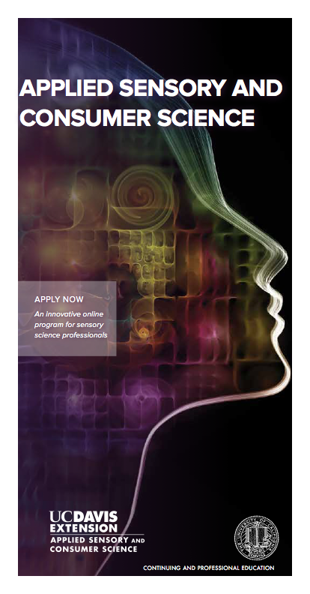
UCDE Applied Sensory & Consumer Science Certificate Program
Foundations of Sensory Science
Sensory Evaluation Methods
Consumer Testing Methods
Applications of Sensory & Consumer Science Principles

Slide 56
Thank You
Janet Williams
JWilliams@Dragonflysci.net

